Slide 1
Program and Area Review Comprehensive Year Fall 2021
Dr. Cynthia Gordon da Cruz
2020-21 Co-Chair PAR
Notes:
Slide 1 Audio: Hi, I’m Cynthia Gordon da Cruz and I’m the Coordinator of Institutional Research at Chabot. Last year in 20-21 I was co-chair of PAR, so this presentation is about program and area review and what to expect in the comprehensive year Fall 2021. Just want to give a moment to give a special thanks to Dr. Na Liu and Dr. Indra Liauw who help out with producing visualizations for this presentation.

Slide 2
Agenda
Review Purpose of the Program and Area Review Process (PAR) at Chabot
Long-Term Goal for PAR
Historical Overview of PAR Submissions at Chabot
Why Qualtrics?
Directions and Timeline for PAR Submissions in Fall 2021
Notes:
Slide 2 Audio: This presentation includes a review of the purpose of Program and Area Review, then I’ll go over a long-term goal the PAR committee came up with last year, I’ll give a historical overview of PAR submissions at Chabot, then I’ll explain Qualtrics and why we’re going to be using Qualtrics this year. And finally I’ll end with very specific and concrete directions of the timeline for submitting PARs this year, in Fall 2021.

Slide 3
Purpose of PAR
The Program and Area Review Process (PAR) at Chabot is a three-year comprehensive and annual review and planning process, which is designed to support the quality and growth of the college as aligned with the Educational Master Plan and College Mission.
Programs & Areas (e.g., academic, service and administrative) review the effectiveness of their areas based on data.
Based on this analysis, programs and areas plan (and request resources) for the upcoming PAR cycle.
The three-year review and planning process comprises:
YEAR 1: Comprehensive Review and Planning Year (e.g., Fall 2021 PARs are submitted to plan for 22-23, 23-24 & 24-25)
YEAR 2: Annual Update (e.g., Fall 2022 PARs are submitted to update plans for 23-24 & 24-25)
YEAR 3: Annual Update (e.g., Fall 2023 PARs are submitted to update plans for 2024-25)
Reviews are the foundation for area, discipline, division, and college planning and budgeting.
The PAR committee develops synthesis statements based on submitted PARs to give to the Planning and Resource Allocation Committee (PRAC).
PRAC distributes the PAR synthesis statement, any additional recommendations from PRAC and the resource and personnel requests to the related shared governance committees and senates (e.g., IST, FIT, SASE, Classified Senate, Faculty Senate, etc.).
Funding recommendations and decisions are made by select shared governance committees, PRAC, senates, senior leadership, and the College President based on the PAR process.
Notes:
Slide 3 Audio: Let’s start with what it is and why we do it.
The Program and Area Review Process or PAR is a three-year comprehensive and annual review and planning process. The reason we do it is to continually support the quality and growth of the college so that we are effectively carrying out our Educational Master Plan and College Mission.
The process starts with PAR teams in each program or area reviewing their own effectiveness based on data.
Then, based on this analysis, programs and areas plan (and request resources) for the upcoming PAR cycle.
PAR at Chabot is on a three-year cycle.
The first year is a comprehensive review and planning year. That’s what we’re in this year. So in Fall 2021, PARs will be submitted to plan for three years, starting in 22-23 and the following two years.
Next year will be an update year, in which we’ll only ask for updates or any new plans in comparison to what you submitted in your comprehensive PAR.
Similarly the third year, will be another update year.
Hopefully the process of completing PAR with your area team leads to new insights about how to best serve students. Additionally, the data is used at the college-wide level for planning and budgeting.
After all the individual programs and areas in the college submit their PARs. The PAR committee develops synthesis statements, looking for college-wide trends and themes. This analysis is handed over to the Planning and Resource Allocation Committee (PRAC).
PRAC distributes the PAR synthesis statement, any additional recommendations they have themselves, along with the resource and personnel requests to the related shared governance committees and senates.
Funding recommendations and decisions are made by the applicable shared governance committees, PRAC, senates, senior leadership, and the College President based on the PAR process.

Slide 4
Long-Term Goal of PAR Committee
Fall 2020-Spring 2021 PAR Committee:
Samantha Kessler (co-chair), Cynthia Gordon da Cruz (co-chair), Christina Read, Safiyyah Forbes, Nancy Pinio, Manny Kang, Zannie Dallara, Alice Hale, Frances Fon, Cynthia Horn, Virginia Criswell, Anamarie Navarro & Christin Verade
Envisioned an integrated app that draws on information from previous year’s PARs, SLO/PLO/SAO assessments, allows for real-time online collaboration with area colleagues as well as Dean/Director/Manager, etc. AND from which we can easily download data to visualize campus-wide trends.
Other committees and initiatives (e.g., OAC, Guided Pathways) are also looking for updated software that would integrate SLO/PLO assessment, Curriculum, PAR, and Program Mapping.
Search is underway, but no new app yet→
Fall 2021 PAR needs a transitional solution…
Notes:
Slide 4 Audio: I want to give a shout out to last year’s PAR committee. All the members are listed on this slide. Together, we envisioned an integrate app that draws on information from previous year’s PARs, SLO/PLO/SAO assessments, allows for real-time online collaboration with area colleagues as well as Dean/Director/Manager, etc. AND from which we can easily download data to visualize campus-wide trends.
Other committees and initiatives, like OAC and Guided Pathways are also looking for updated software. This software would hopefully integrate SLO/PLO assessment, Curriculum, PAR, and Program Mapping.
This search is underway, but we don’t have a new app yet.
So Fall 2021 PAR needs a transitional solution…

Slide 5
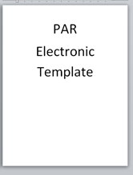
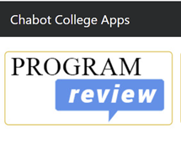
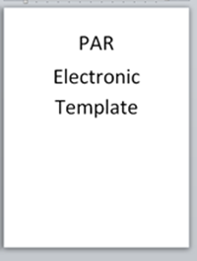
A Brief History of PAR Submissions at Chabot
Fall 2021
Future
Notes:
Slide 5 Audio: In order to contextualize the transitional solution for Fall 2021 PAR submissions, I want to take a look backwards at the history of PAR submissions and a look forwarded at where were headed. We started in the stone age, just kidding. Originally PARs were submitted on paper and the PAR committee and PRAC were left to analyze and make sense of reams of paper, then we moved to electronic templates and submissions, next, thanks to the hard work of those who have come before us, our own homegrown Chabot program review application was developed. This was a huge step forward for the college. As we continue to grow and get and review more and more data, we now need an app that allows for easy integration of the entered data. As I mentioned on the previous slide, several committees are currently looking into purchasing such an app, but we don’t have it yet. So in the mean time, we’re going to use electronic templates, combined with Qualtrics an advanced survey tool. I’ll explain why in the coming slides.

Slide 6
Why Qualtrics?
Qualtrics is an advanced survey software that allows for easy analysis and visualizations
By including more quantitative questions, and gathering the data on Qualtrics, the PAR committee (with the support of OIR) will be able to report back on campus-wide trends and achievements.
Notes:
Slide 6 Audio: The short answer to “Why Qualtrics?” Is that it allows for easy analysis and visualizations of the campus-wide data. By including more quantitative questions, and gathering the data on Qualtrics, the PAR committee (with the support of OIR) will be able to report back on campus-wide trends and achievements. For the longer answer to “Why Qualtrics?” I need to show you the kinds of things that it can do.

Slide 7
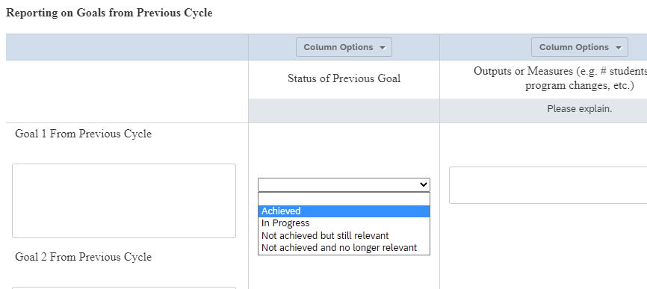
Example PAR Question in Qualtrics
Notes:
Slide 7 Audio: So here’s an example of one of the Fall 2021 PAR Questions. The PAR committee asks programs and areas to reflect and report back on goals from the previous cycle. Programs and Areas will need to enter whether their previous goals have been achieved, are in programs, not achieved but still relevant, or no longer relevant. Because all programs and areas will enter this data into Qualtrics, we’ll then be able to produce a graph of campus wide data.

Slide 8
From Qualtrics Entry to Visualization of Campus-Wide Data
Q15 - Reporting on Goals from Previous Cycle - Status of Previous Goals
Notes:
Slide 8 Audio: Here’s an example of what it could look like. We can see trends in whether college wide programs and areas are able to reach their goals by looking at the aggregated data. In this fake example, thanks IR team for making up some data, 75% of programs and areas achieved their goals, 10% were still working on those goals, and only 5% had goals that were still relevant but that they hadn’t had a chance to start.

Slide 9
Example PAR Question in Qualtrics
Enrollment Disaggregations: FTES is directly connected to enrollments, but it is complex to disaggregate. Enrollments (or the number of class seats enrolled in your discipline in a given time period), can be disaggregated by race and ethnicity, gender, etc. Take a look at disaggregations of your enrollments by race and ethnicity (and/or by gender) over the past three years on the Chabot College Course Enrollments and Success Rates Dashboard. Consider how the representation of traditionally underrepresented race/ethnicity/gender student groups in your program compares to the typical makeup of your discipline, field, or industry.
Notes:
Slide 9 Audio: Here’s another question on the Fall 2021 PAR. One of the questions that academic programs are asked to analyze is their enrollments disaggregated by race and ethnicity. Programs have been asked to analyze this for many years, but the challenge with paper, electronic template, or the Chabot Program App is that we didn’t have a good way to aggregate all the data and understand what was happening campus-wide. Individual programs knew how they were doing, but there was no way to see this college wide without reading 100 PAR submissions. By creating categories like (representation could be improved, it’s just right, or it’s outstanding-we are increasing the diversity of the field) and asking PAR teams to enter this data into Qualtrics, we’ll be able to easily aggregate the data and see how we believe we are doing as a campus with regard to representation in our enrollments.

Slide 10
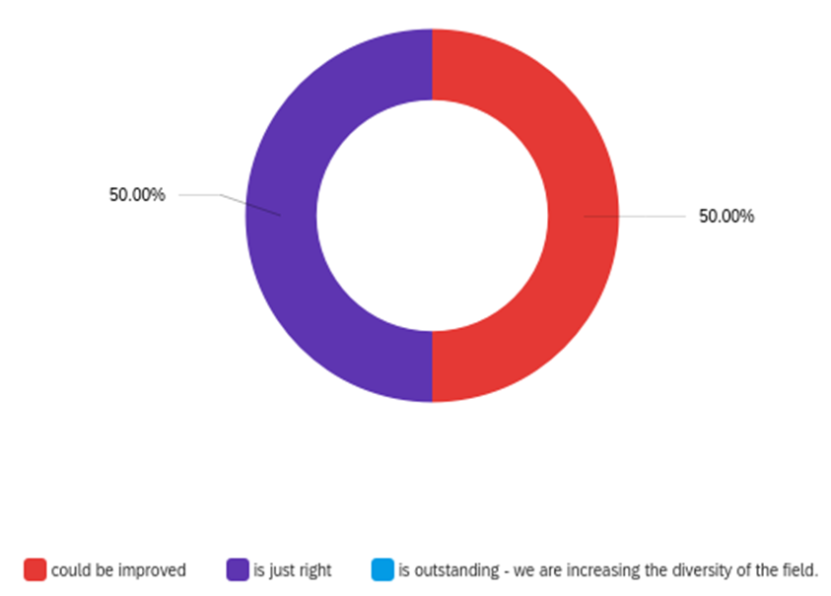
From Qualtrics Entry to Visualization of Campus-Wide Data
Notes:
Slide 10 Audio: In this chart, after all programs analyze their own data and enter it into Qualitrcs, we’ll be able to produce a graph like this that shows campus-wide trends in representation (again just fake data this is just an example of graphs we could produce because PAR teams will be entering their data into Qualtrics).

Slide 11
Example PAR Question in Qualtrics
Notes:
Slide 11 Audio: With the previous question, we’ll be able to see generally how programs or areas believe they are doing with regard to representation, but we won’t be able to tease out which groups are impacted. In this next question on success rates, the PAR Committee asks programs to look at their success rates disaggregated by race, ethnicity, and gender and analyze whether they see disproportionate impact (or lower success rates) for any one particular group.

Slide 12
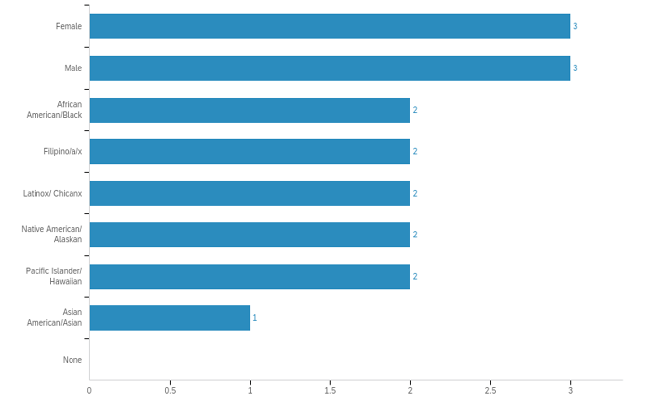
From Qualtrics Entry to Visualization of Campus-Wide Data
Notes:
Q24 - Do any populations jump out to you as disproportionately impacted (succeeding at lower rates than students from other racial/ethnic, gender groups, or the overall college population)? Check all groups that are disproportionately impacted (succeeding at lower rates than students from other racial/ethnic, gender groups, or the overall college average).
Slide 12 Audio: Because PAR teams will enter this data into Qualtrics, we’ll be able to easily aggregate this data campus-wide to see if there are any trends in which groups Programs and Areas believe are disproportionately impacted.

Slide 13
Fall 2021 Transition Year
(Surmountable) Challenges:
Area/Program teams will need venue for collaboration to complete the electronic template.
Suggestion: upload the PAR template (posted on the committee website) into google docs and invite your PAR team as collaborators
After submitting electronically to your Dean/Manager and receiving their feedback and approval, one person will need to:
Enter the data from the template into Qualtrics
Upload the applicable attachments (e.g., classified professional prioritization requests, discipline plans, etc.).
Notes:
Slide 13 Audio: So I’ve shown you all cool graphs and helpful analyses we’ll be able to do as a result of having PAR teams submit their PARs by entering them into Qualtrics, but I can imagine that folks may be wondering, are there any drawbacks? If it’s so cool, then why is this just a transition and not the new app? I do think there is one major drawback with Qualtrics. It’s an app for gathering and analyzing data. But it’s not an app for online collaboration. That was something that we had in the homegrown Chabot PAR app and it’s something that we are moving towards with our goal of purchasing an integrated app that integrates many campus-wide systems. For this year, Area/Program teams will need venue for collaboration to complete the electronic template. One suggestion is to upload the PAR template (that will be posted on the PAR committee website) into google docs and invite your PAR team as collaborators. The second small but surmountable challenge is that once a PAR teams submits your PAR template to your Dean/Manager. You might feel like you’re done! But wait! There is one more step. Once you receive your Dean’s/Manager’s feedback and approval, one person will need to go into Qualtrics and enter the data from the template. Because this is a new step, it might be easy to forget. But don’t worry, the PAR Committee and your Dean’s/Manager’s will provide you with plenty of reminders to get those PARs submitted in Qualtrics.

Slide 14
Fall 2021 Timeline
9/8/21 Program & Area Review Launch: Fall 2021 Templates Available on PAR Website
Data Available via PAR or IR websites (with one exception Degrees and Certificates)
9/8/21- 9/30/21 Trainings: PAR Committee is available to provide trainings upon request (e.g., real-time presentation of this ppt with Q & A, “tour” of PAR website and forms, etc.)
9/8/21- 10/11/21 Area/Discipline PAR Teams Collaborate: to complete their PARs in the electronic template provided
10/11/21 PAR Electronic Template Reviews Due: to Deans/Managers
Remember to submit template and attachments.
Dean/Area Manager Provide Feedback and return to PAR teams for final submission via Qualtrics
10/25/21 Final PAR Reviews Due: After receiving approval from Dean/Manager, one person per PAR team submits on Qualtrics
11/8/21 Dean & Area Manager Summaries Due: Submit on Qualtrics
11/11/21 Data Analysis Begins: PAR Committee Analyzes Data (11/11 & 12/9); develops Synthesis Statements
1/28/22 Synthesis Statements Target Date: PAR Submits Synthesis Statements to PRAC for their review
Notes:
Slide 14 Audio: Now I’ll go over the nuts and bolts of what to expect for Program and Area review, Fall 2021. We’re planning to launch on September 1st and on that date the templates will be available on the PAR website for download so that each of the PAR teams can fill out a PAR for your program or area. We’ll also have data available by this point either via the PAR website or on the IR website with the one exception that degree and certificate data is not received by IR until early to mid-September, so as soon as we get it, we’ll post that as well.
From September 1st through September 30th the PAR committee is available to provide trainings. We’re happy to answer any questions you have about this PowerPoint, give a tour of the PAR website where you can find forms, and answer any other questions that you may have.
From September 1st to October 11th, that’s when your area/discipline teams are going to be collaborating to complete your PARs in the electronic templates that are provided on the PAR website. Then on October 11th, that’s when those electronic templates are due to your Deans and Managers. So you will submit to your Deans and Managers however they request it to be submitted to them. And remember you need to submit both the PAR template, as well as any attachments based on what sort of resources you’re requesting.
Your Deans and Area Managers will provide feedback and then they’ll return your template to your team for final submission on Qualtrics and the goal is that by October 25th the final PAR should be submitted in Qualtrics so once you get the approval from your dean or manager it just takes one person per PAR team to submit the data on Qualtrics. I estimate that process will take about 15 minutes from start to finish to transfer the data from your template into Qualtrics so that we have a place to analyze the data campus-wide.
On November 8th, Dean and Area Managers will be completing summaries of all of the PARs within their areas and then on November 11th the fun for the PAR Committee begins and we’ll start to analyze the data that you all have submitted into Qualtrics. Finally, on January 28th, 2022--that is our target date for PAR to submit synthesis statements, any graphs or figures from Qualtrics that allow us to synthesize campus wide trends in how people have responded to their program and area reviews.

Slide 15
Will this process be seamless?
Probably not.
PAR Committee finished a draft template of questions by our last meeting spring 2021; we did not have time develop separate templates for academic, service, and administrative areas, nor time to collaboratively develop the submission process.
Director Kessler & Dr. Gordon da Cruz planned to finish over the summer
Director Kessler moved.
The ISER took over IR’s lives!
If we over-looked something crucial, please email your feedback to the PAR 21-22 Co-Chairs:
Faculty Co-Chair: TBD pending senate approval. Cynthia Gordon da Cruz has volunteered
Administrative Co-Chair: Deonne Kunkel-Wu
We will do our best to build the plane as we fly it!
Notes:
Slide 15 Audio: Finally, I’d like to end this presentation with a bit of transparency and perhaps ask for an extension of grace.
Do I think this process will be seamless? Probably not.
The PAR committee finished a draft template of questions by our last meeting in spring 2021, but we did not have time to develop separate templates for academic, service, and administrative areas, nor did we really have time to hammer out the submission process that I just talked to you all about. Dr. Kessler and myself planned to finish up over the summer, but then Dr. Kessler moved and the ISER took over IRs lives so it is entirely possible that we have overlooked something. If that’s the case, then please email your feedback to the PAR 21-22 co-chairs and they will do their absolute best to help you. The administrative co-chair for this year is going to be Deonne Kunkel-Wu. I have volunteered to be the co-chair for faculty, but that is pending senate approval, so if there’s any update to that we will reach out and let you know. We will do our best to build the plane as we fly it and hopefully to make this Fall 2021 Program and Area review as helpful and useful to the institution as possible, in order to carry out our mission and serve students in the best way possible.

